Slide 1
7-11 JUNE 2021

Slide 2
Opportunity for meeting different instructors from different countries...
5 different instructors
Registration to the courses will be online
on 20,21 of April 2021
Link will be announced at the website of the Faculty& DEU SAKAI online teaching system !
CONTENT OF THE PRESENTATION
instructions, content of the courses and instructors of International Week .

Slide 3
Important Issues
Registration
20th and 21st of April 2021
Registration will be done via Google Docs and link will be announced at the website of the Faculty & DEU SAKAI online teaching system
You can select only one course
Registrations will be done on first come first served bases
Be carefull each course has a quato !
To obtain 1 ECTS credit participation and full attendance is obligatory to the international week courses

Slide 4
International Week (IW) Rules
You take only one course
IW courses will be held 8,9,10 of June 2021.
Course time: 8,9,10 June morning from 11.00 to 12.15
IW class lists will be announced in April at the website of the Faculty
Since IW is a Faculty activity , you will be permitted from the courses you are already taking at the Faculty.

Slide 5
Participation and Attendance
Students will be on the ‘’ Black List ‘’ for the future International Weeks, if you don not attend the course that you are already registered.
Being on the ‘’Black List’’ means you can not obtain course from the coming IW’s.

Slide 6
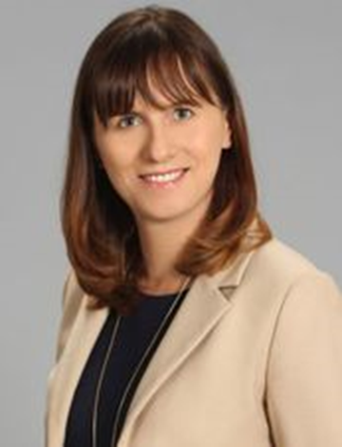
Dr. Anna Kuzior University of Economics in Katowice, Poland Why and How do Companies Play on Accounting Policy (based on IFRS)
Course Objective:
Understand the purpose and qualitative characteristic of financial statements
Understand the idea and tools of accounting policies,
Be able to discuss and critically asses methods of measurement of fixed and current assets,
Understand the influence of assets valuations rules on compan’s financial position,
Be able to take decision concerning a choice of accounting policies tools and techniques in particular situations
3rd and 4th year students
Class quota is limited with 30 students
Business, Economics, Int’ l Business & Trade Students can register

Slide 7
Dr. Richard Smilnak Moravian Business College Olomouc, Check Republic The world economy in your living room
This is a story about humans. The course is divided into three parts which are further split into a total of nine lecture hours. The first part is focused on the three sectors where human activity is densely concentrated. The second part deals with the three processes that are closely tied to the recent human development while the final part zooms in on our activity and concludes by narrowing the scope down to a single actor within the world-economy ecosystem.
3rd and 4th year students
Class quota is limited with 50 students
Students from economics, business and int’l business&trade dept.
can register

Slide 8
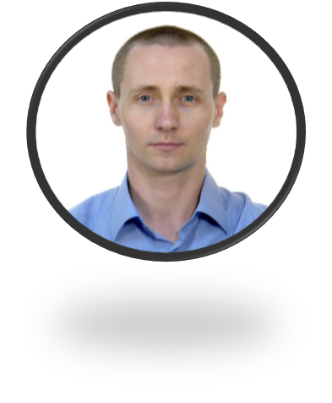
Dr. Alexander Boldyrikhin Voronezh State University, Russia Business Enviroment in Russia : Pratical Experience, Overview and Trends
Course Objective:
The objective of this course is to introduce students to the special features of business practice in the emerging market of Russia with an emphasis on understanding its role and place in the global business system.
know the main practical frameworks of doing business in Russia;
be able to understand the processes and challenges that are going within the Russian business system in close connection with the political processes;
have experienced business cases from real companies working in the Russian market.
2nd, 3rd and 4th year students
Class quota is limited with 50 students
Students from all departments can register

Slide 9
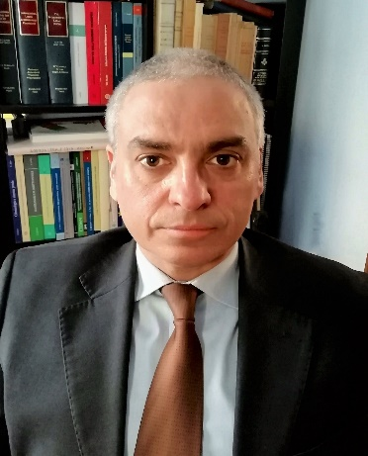
Prof. Dr. Paolo Bargiacchi Kore University of Enna, Italy Revising legal rules and strategies for tackling modern international security threats
Course Objective:
Learn how international law is evolving to properly address contemporary security threats
Assess related consequences for international law and international relations
Compare drivers and push/pull factors for protecting both human rights and State security
Assess the impact of the R2P doctrine on international law and international relations
Learn about EU’s interpretation of human security and EU global strategy for democracy
2nd, 3rd and 4th year students
Class quota is limited with 30 students
International Relations Students can register

Slide 10
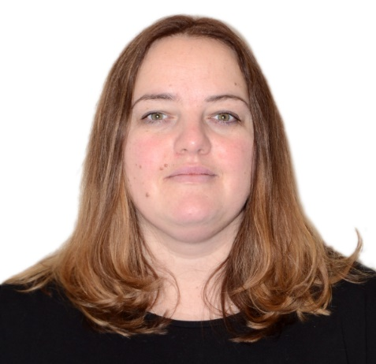
Dr. Irina Foret Voronezh State University , Russia Ethnic Conflicts in the modern world
Course Objective:
to analyze the political content of the international conflict, the real interests and goals of its participants;
to understand the principles of international conflict management;
to be able to critically interpret the experience of practical use of international conflict basic methods;
be able to analyze the factors that lead to the escalation of conflicts and its conversion into the armed confrontation
2nd, 3rd and 4th year students
Class quota is limited with 30 students
Students of International Relations department can register

Slide 11
IW Course Hours ( 8,9,10 June )
8th of June 2021 , Tuesday
11.00-12.15
9th of June 2021 , Wednesday
11.00-12.15
10th of June 2021 , Thursday
11.00-12.15
Class lists of the IW will be announced at the end of April at the website of the Faculty.

Slide 12
Thanks for listening...
QUESTIONS???

